Slide 1



Electrical & Electronics Engineering Department
EE493&494 - Engineering Design
“Cısss!”
Lambda
Shareholders:
Berk Erhan Yüksel
Necdet Can Sönmez
Mustafa Barış Emektar
Alper Saraç
Furkan İtkü

Slide 2
Outline
Company Introduction
Problem Statement
System Requirements & Objectives
Design Process & Solution Approach
Detection Subsystem
Control Subsystem
Alerting Subsystem
Conclusion

Slide 3
Company Introduction
Lambda Company was established in October 2021 at METU, Ankara.
Mission
To provide innovative, reliable products and energy-efficient solutions in the field
of electronics and system integration, and to make people's lives easier with the
projects it produces.
Innovative
Technological Development
Creative
Reliable
Energy-efficient
Environmentally
Human-friendly
Vision
To be a reliable, innovative, environmentally and human-friendly technology company that maintains its sustainable growth with the values it creates.

Slide 4
Problem Statement
Design and construct a device to help keep pets away from designated locations.
Control a pet’s behavior around the house.
“Cısss!”

Slide 5
Problem Statement
Master Unit
Detect the pet when pet is approaching forbidden areas
In case of violation of forbidden areas, the main unit should warn the pet.
The device will consist of two types of units:
A single mobile (wearable) smart “MASTER” unit.
Several (as many as necessary) identical “TAGS”.
Tags
Placed in designated forbidden zones
Area tags should be for the detection of the pet’s entry into an area or doorway

Slide 6
System Requirements & Objectives
Requirements
Detect the pet when pet approaches forbidden areas (Zone)
Detect the pet when pet goes through the door (Doorway)
Sense four different distance ranges to warn the pet in four stages of increasing alarm strength
Warn the pet with electrical, mechanical, or acoustic stimulus, these warnings should not be harmful.
The distance between the two door sills should be a minimum of 90 cm.

Slide 7
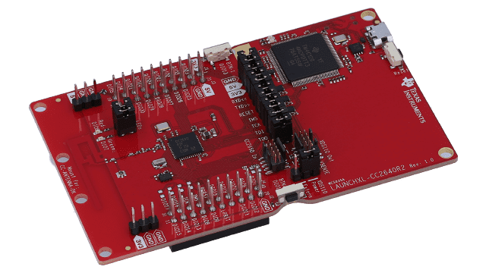
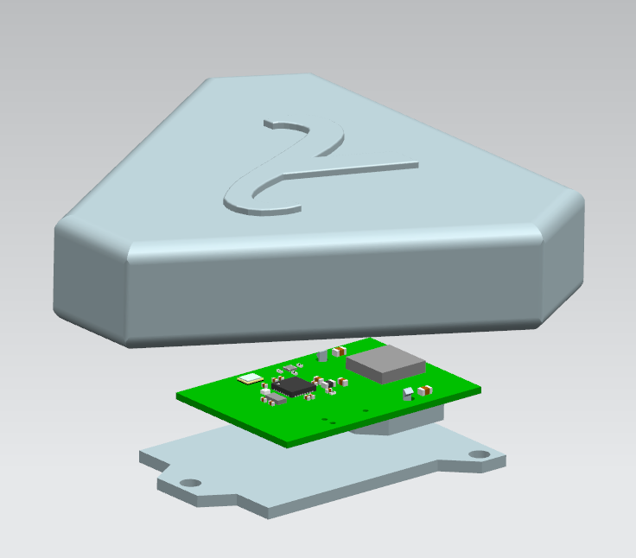
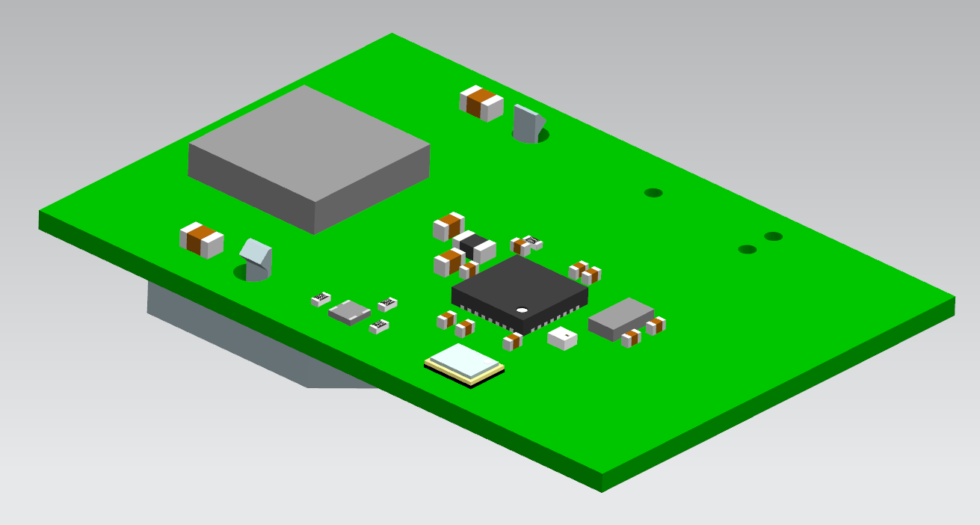
Figure 5:TI LAUNCHXL-CC2640R2
Figure 7: Designed 3d Model Enclosure for PCB
Figure 6: Designed PCB

Slide 8
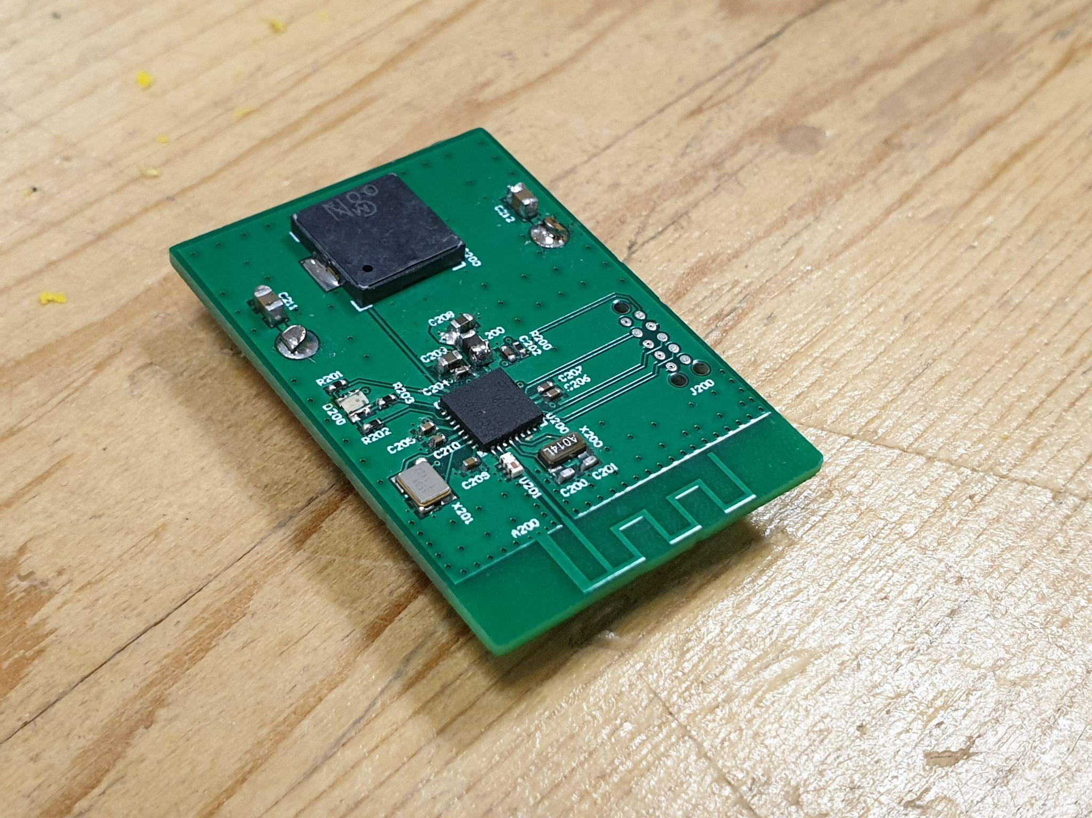
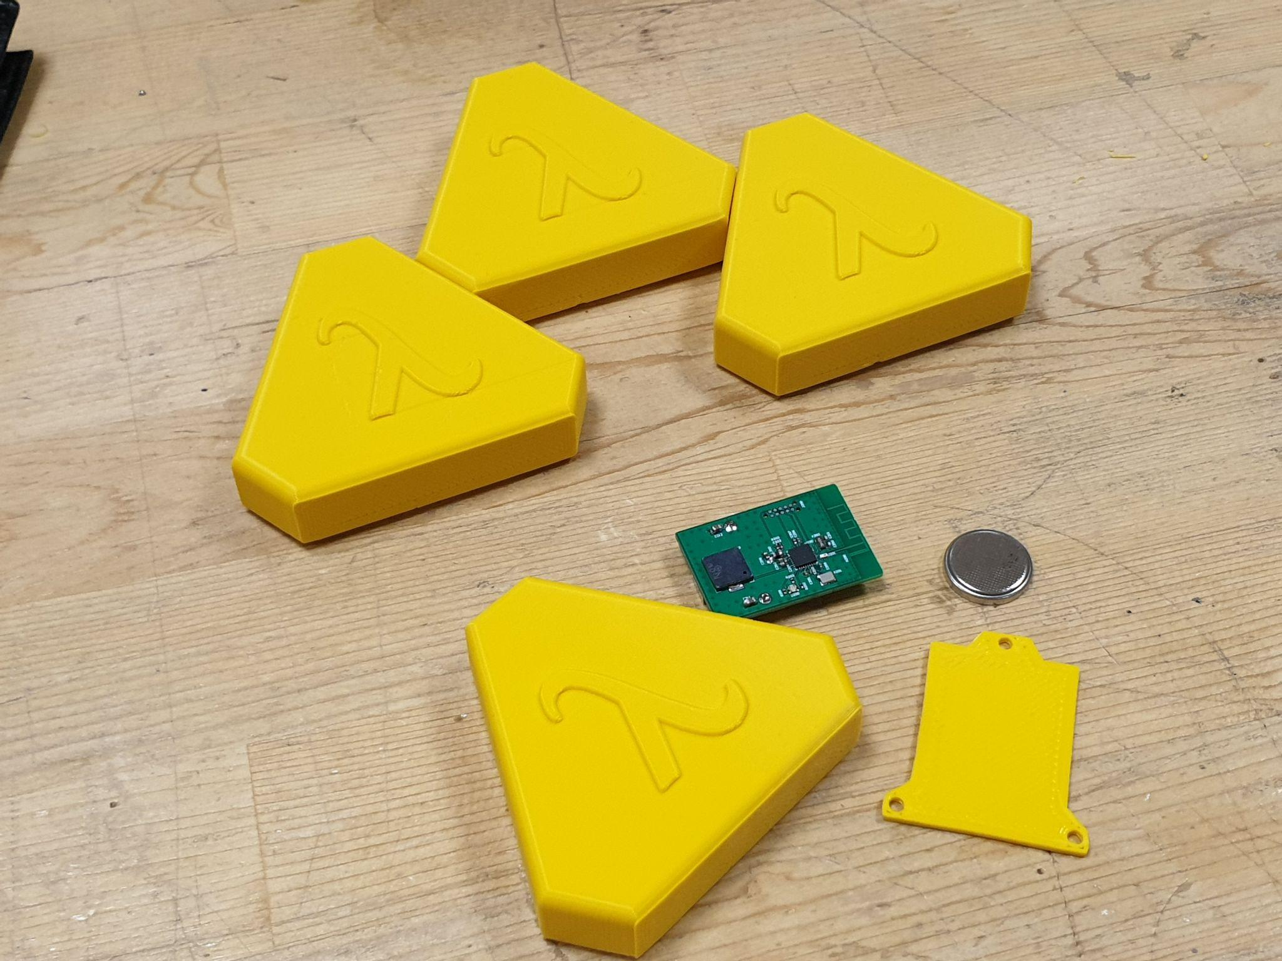
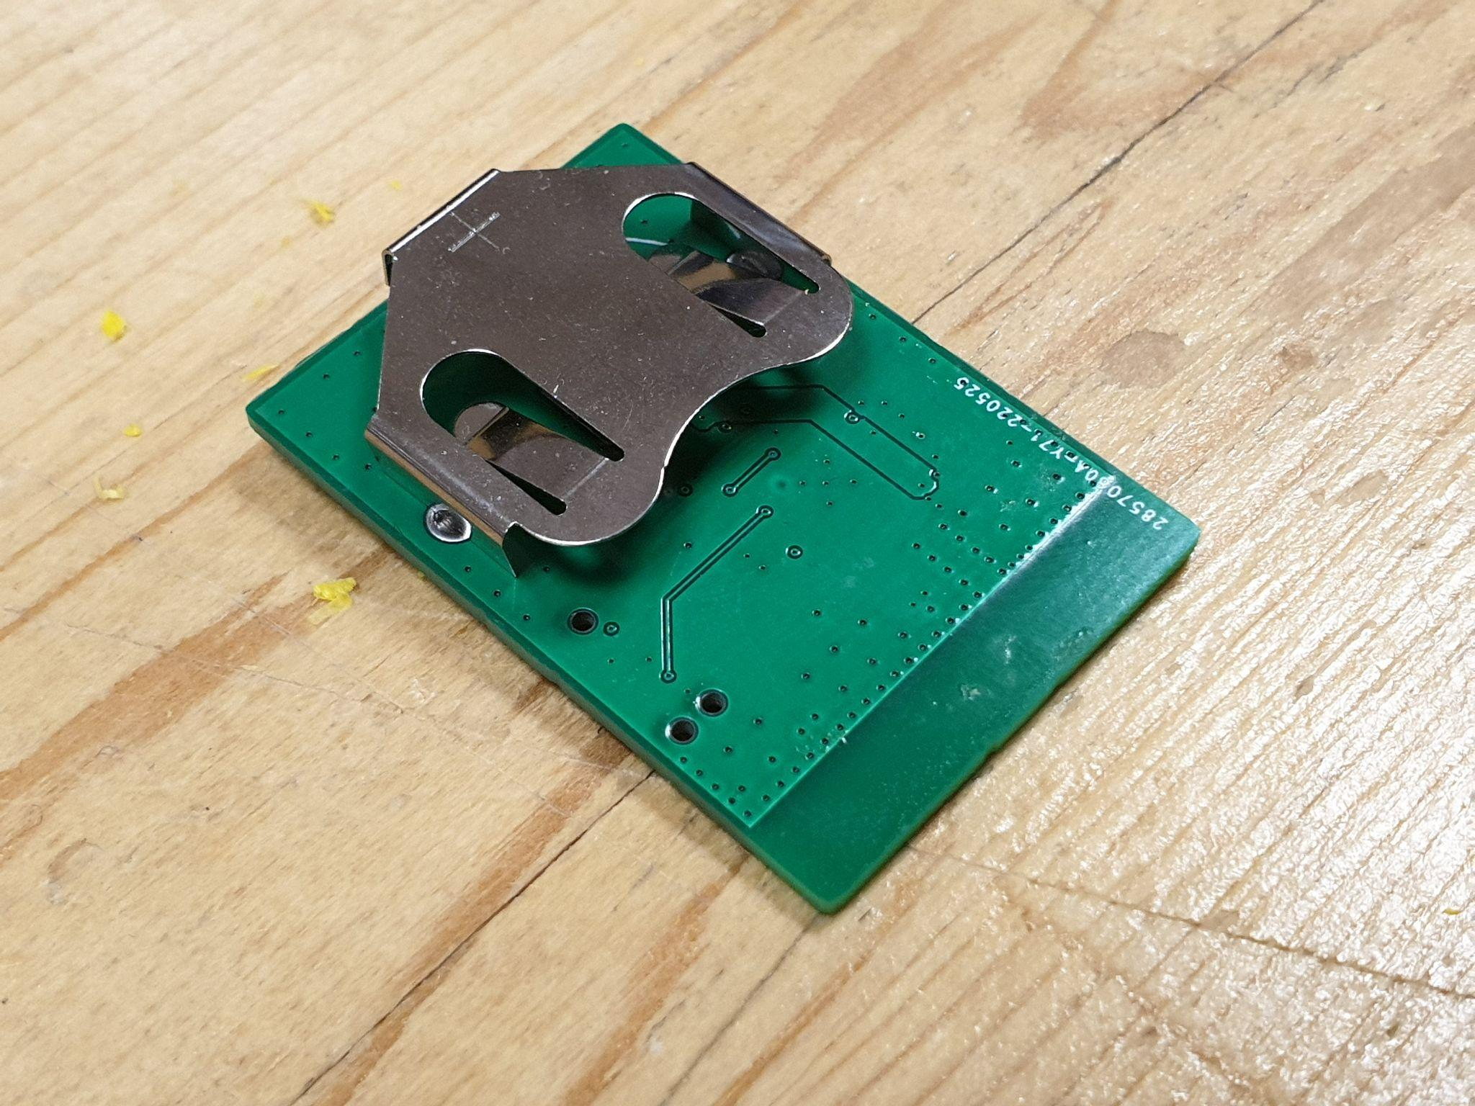

Slide 9

Design Process & Solution Approach
Detection Subsystem
Control Subsystem
Alerting Subsystem

Slide 10
Detection Subsystem
Core subsystem of the project.
Measurements should be correlated with distance.
Should operate robustly.
Precision of the measurements should be good enough.

Slide 11
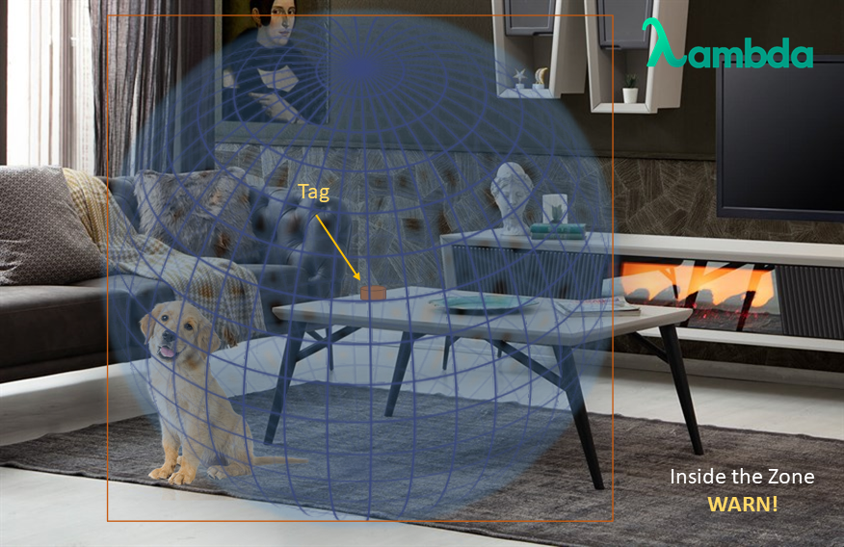
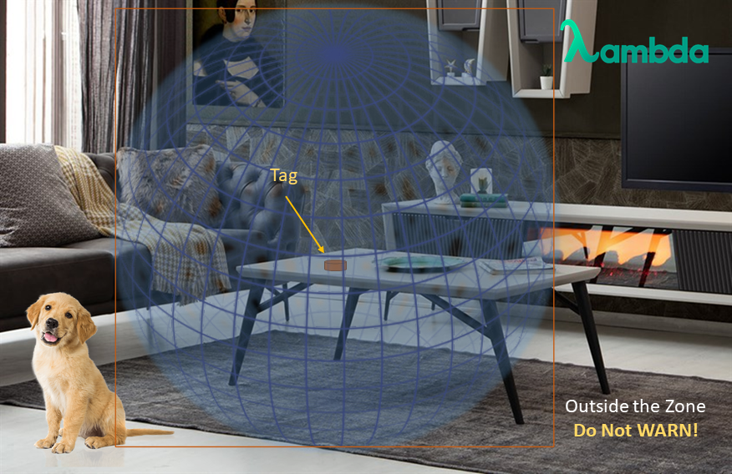
Zone Tag
Figure 4: Zone Tag Explanation

Slide 12
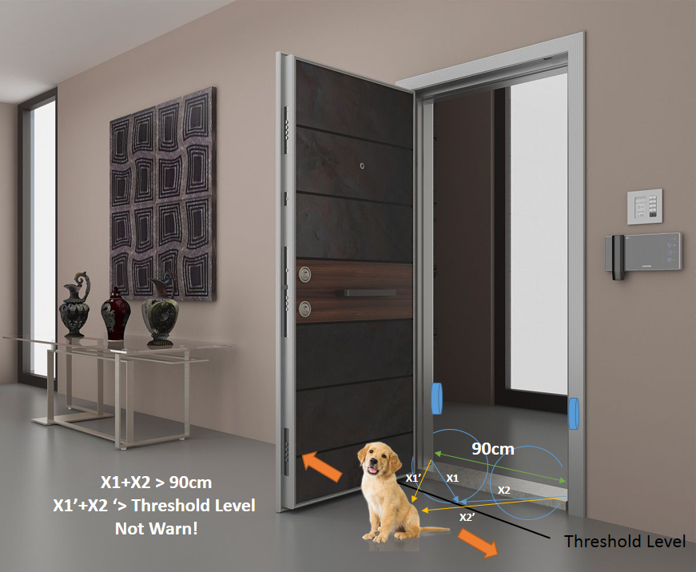
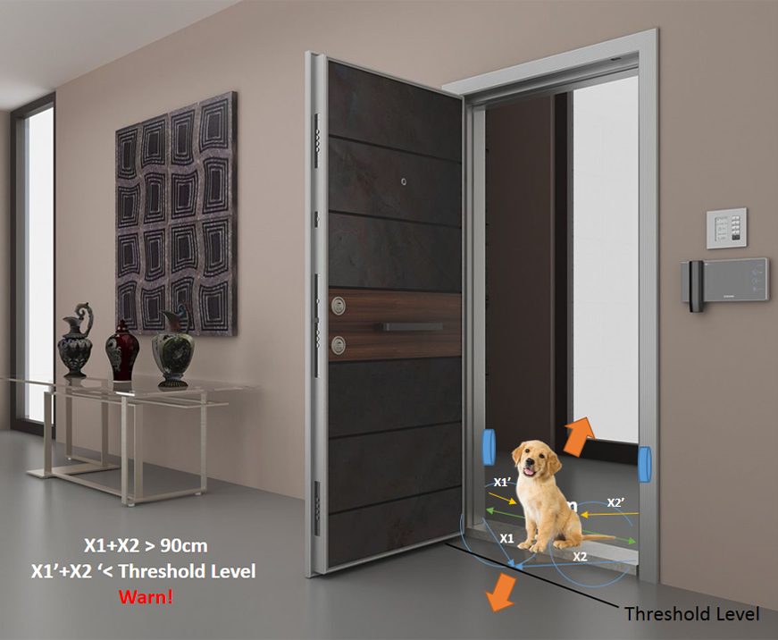
Door Tag
Figure 3: Door Tag Explanation

Slide 13
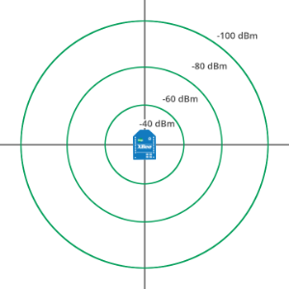
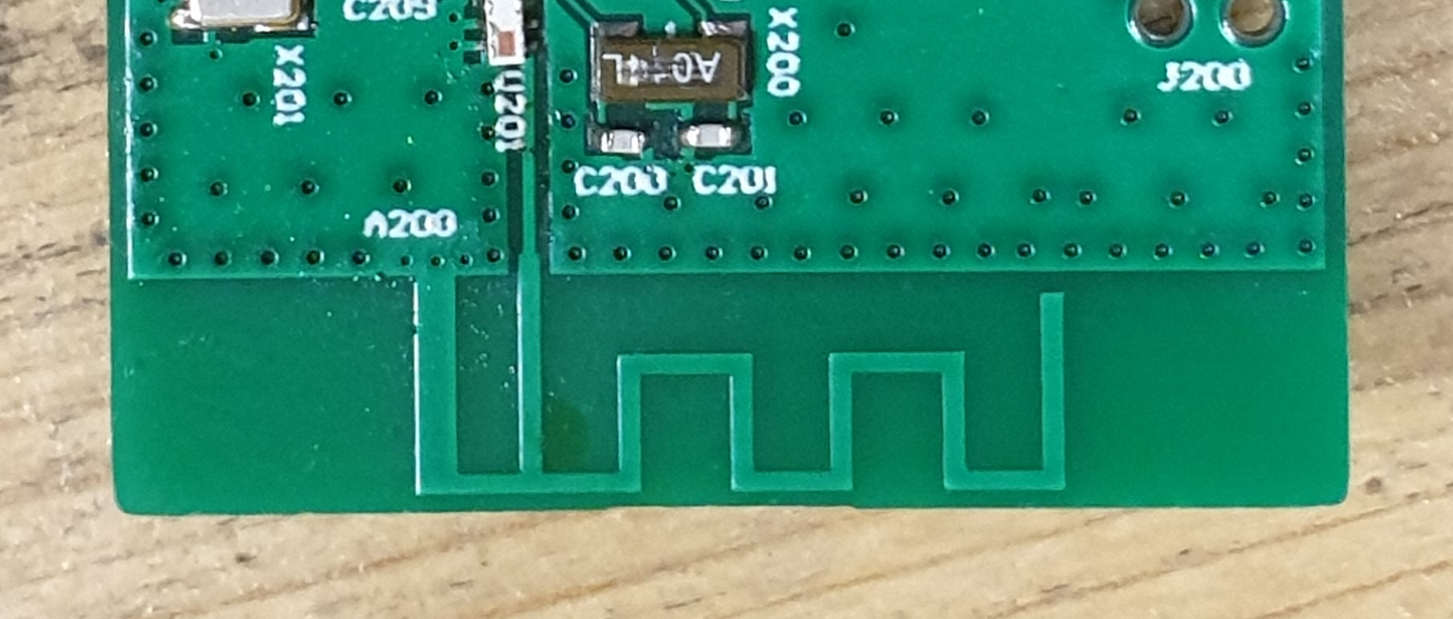
RSSI Measurement Using RF
RF communication in 2.4 GHz is used.
Tag receives signal from master unit.
Tag responds with another signal.
Master units receives this signal and measure its RSSI value.
Figure 4: A Simple Demonstration of the RSSI Technic

Slide 14

Control Subsystem
Hardware used
Main structure of the program
Filtering process

Slide 15
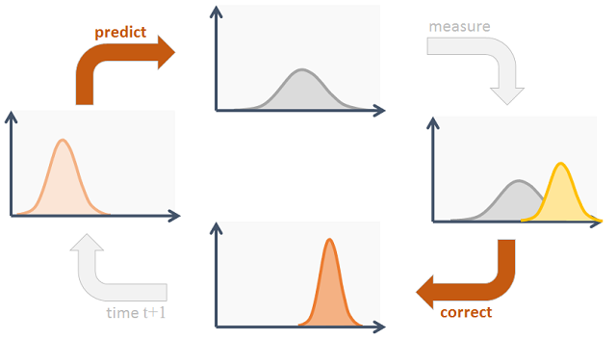
What is a Kalman filter?
x_{t}=A_{t}x_{t-1}+B_{t}u_{t}+e_{t} & z_{t}=C_{t}x_{t}+d_{t}
A Kalman filter uses the previous state, as well as the “uncertainty” in the system to “predict” which state the system will be in next
“Kalman gain” dictates how much we will depend on our measurement and how much on the previous state
Kalman gain is updated every cycle according to the uncertainty, which is a metric of how much error there is in the system

Slide 16


Alerting Subsystem
Using a Buzzer Module
A buzzer is used to generate sound, similar to a speaker

Slide 17




Thanks for Listening
Company Lambda

